Slide 1
CNN-based Steganalysis of MP3 Steganography in the Entropy Code Domain
[Wang Deep Audio Steganalysis Network(WASDN)]
Institute of Information Engineering, CAS
State Key Laboratory of Information Security (CKLOIS)
Yuntao Wang (Speaker) Kun Yang Xiaowei Yi Xianfeng Zhao
IH & MMSec’18, Innsbruck, Austria
Notes:
Good afternoon, everyone. My name is Wang Yuntao. I am glad to bee here for this presentation. I am a postgraduate in Institute of Information Engineering, and my major research filed is audio steganalysis. Today, I will introduce our recent work on steganalysis of MP3 steganography based on CNN.

Slide 2
Outline
1. Introduction
2. Impact of Steganography on MP3 Audio
3. Structure of Network
4. Experiments and Analysis
5. Conclusion
Notes:
This is the outline of the presentation. And we will detail our work from the following five aspects.

Slide 3
Outline
1. Introduction
2. Impact of Steganography on MP3 Audio
3. Structure of Network
4. Experiments and Analysis
5. Conclusion
Notes:
First, the introduction.

Slide 4
Introduction
Carrier Selection
Notes:
Generally speaking, there is five type of carriers for steganography, and Audio is an important one. The reason can be summed up to the following three points.

Slide 5







Introduction
Why Audio Format?
spread widely
large potential embedding capacity
Abundant subliminal transmission channels
Notes:
1. First, audio is widely spread across the internet. Everyone enjoys audio services through music app, online radio and so on.
2. Next, the potential embedding capacity of audio is larger. For example, a WAV audio of 4 minutes duration, the size is 40 (forty) megabytes ['meɡəbaɪt], and a MP3 audio of 4 minutes duration, the size is 4 megabytes. So the potential embedding capacity is larger compared with the image.
3. And, last, there are abundant subliminal transmission channels. According to our survey before, there are many audio sharing platforms on the Internet, such as clyp, yourlisten and so on. The audio files won’t be transcoded or recoded on these platforms and the audio files can be uploaded and downloaded directly, which are applicable for audio covert communication.

Slide 6




Introduction
Why MP3 Format?
MP3? WAV?
AAC?
Network
Embed
Transfer
Extract
Stego?
Cover?
Notes:
While, among all audio formats on the internet, over 60 percent of the audio resources is MP3 due to its high compression ratio and high quality. And almost all sharing platforms shown in the slide are for MP3.
Therefore, MP3 steganalysis is necessary to be studied.

Slide 7
Introduction
MP3 Steganography
HCM : embed message by Huffman Code Mapping in big-value region
CLIN : Change the LSB of less significant LINbits
MP3Stego : change the parity of coded granule length by controlling quantization
APS (Adaptive Post-Steganography) : change the LSB of less significant Huffman codes in count1 region. Only the payload is adaptively decided
EECS (Adaptive MP3 Steganography Using Equal Length Entropy Codes Substitution) : Equal Huffman Code Substitution with STC and distortion function based on Psychoacoustic model (PAM)
Notes:
Until now, many MP3 steganographic algorithms have been proposed. MP3 steganography is usually combined with its encoding process to get a larger embedding capacity. The embedding operation is located at bit allocation loop.
MP3stego changes the parity of coded granule length by controlling the quantization.
HCM embeds message by Huffman Code Mapping.
CLIN changes the LSB of LINbits.
APS changes the LSB of small Huffman codes. Its payload is adaptively decided.
And EECS is an adaptive MP3 steganography proposed last year, and this algorithm is more secure than other data hiding methods which is hard to be detected via traditional handcrafted features. So our proposed network is mainly aimed to detect this algorithm effectiely.

Slide 8
Outline
1. Introduction
2. Impact of steganography on MP3 audio
3. Structure of network
4. Experiments and analysis
5. Conclusion
Notes:
Before we introduce the structure of the network, we can have a look at the impact of steganography on MP3 audio.

Slide 9
Impact of steganography on MP3 audio
MP3 encoding and structure of QMDCT (Quantified Modified DCT) coefficients
Diagram of MP3 encoding
Structure of codewords in big-value region
Structure of QMDCT coefficients
Structure of codewords in big-value region
Notes:
First, we introduce the MP3 encoding and the structure of QMDCT coefficients in order to make it easier for us to understand the following content. Here, QMDCT is the abbreviation of quantified Modified DCT.
This is the diagram of MP3 encoding. As I just described, the embedding operation is located at the stage of bit allocation loop.
In this stage, a mapping relationship is established between the huffman code and QMDCT coefficients. As we can see from this figure. The QMDCT coefficients consist of three kinds of regions – big-value region, count1 region and rzero region. Every code word in big-value region corresponds to two coefficients – x and y. Every code word in count1 region correspond to four coefficients – v, w, x and y. All elements in rzero region is zero value. That is to say, the modification of Huffman code is equal to the modification of QMDCT coefficients.

Slide 10
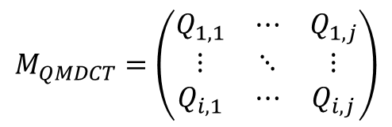


Impact of steganography on MP3 audio
QMDCT coefficients matrix
$$M_{QMDCT}=\left(\begin{matrix}Q_{1,1} & ⋯ & Q_{1,j} \\ ⋮ & ⋱ & ⋮ \\ Q_{i,1} & ⋯ & Q_{i,j}\end{matrix}\right)$$
$$i=4×N, i∈[1, 200]$$
$$j∈[1, 380]$$
Diagram of QMDCT coefficients matrix
Notes:
To detect MP3 steganalysis effectively, some pre-processing methods need doing. This is the expression of QMDCT coefficients matrix. Therein, i is the index of channels, j is the order of QMDCT coefficients in a granule. In common MP3 audio with stereo channels, a frame consists of two granules, and a granule consists of two channels. We catenate [‘kætɪneɪt] the QMDCT coefficients channel by channel. Therefore, i is equal to 4 times the number of frames N. In our paper, 50 frames is selected as the analysis unit. Besides, according to the introduction of coefficients before, there are some 0 elements at the end of each channel. This part won’t be changed by the algorithm. So, in order to reduce the computation and enlarge the difference between cover and stego, we choose the first 380 (three hundred and eighty) elements to analyze. This is an empirical value.

Slide 11
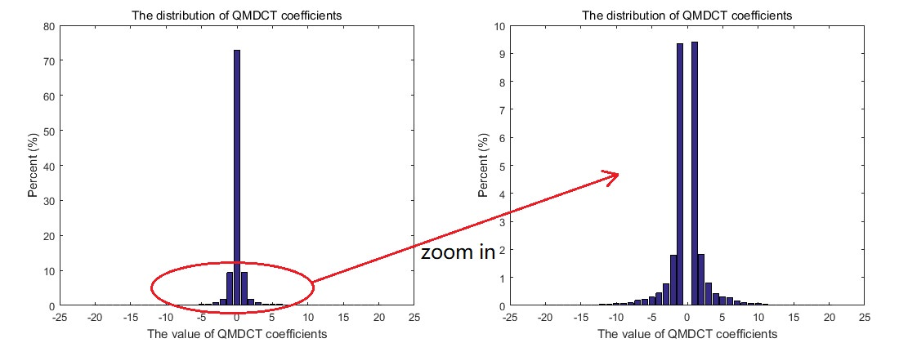

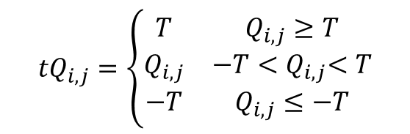
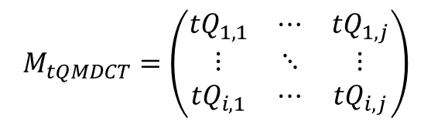
Impact of steganography on MP3 audio
QMDCT coefficients matrix
$$M_{tQMDCT}=\left(\begin{matrix}{tQ}_{1,1} & ⋯ & {tQ}_{1,j} \\ ⋮ & ⋱ & ⋮ \\ {tQ}_{i,1} & ⋯ & {tQ}_{i,j}\end{matrix}\right)$$
$${tQ}_{i,j}=\left\{\begin{matrix}T & Q_{i,j}≥T \\ Q_{i,j} & −T{<Q}_{i,j}<T \\ −T & Q_{i,j}≤−T\end{matrix}\right.$$
$$T=15$$
Notes:
Besides, all QMDCT coefficients are distributed between -15 (negative fifteen) and positive 15 (fifteen), so the matrix is truncated with threshold 15 (fifteen) or less. This is not necessary.

Slide 12
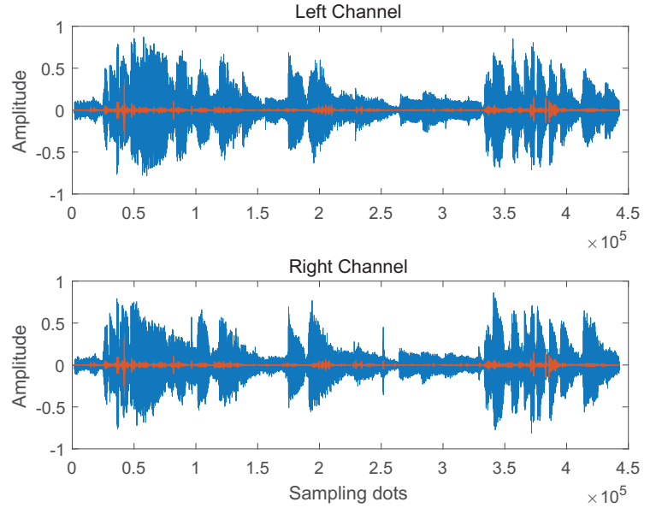
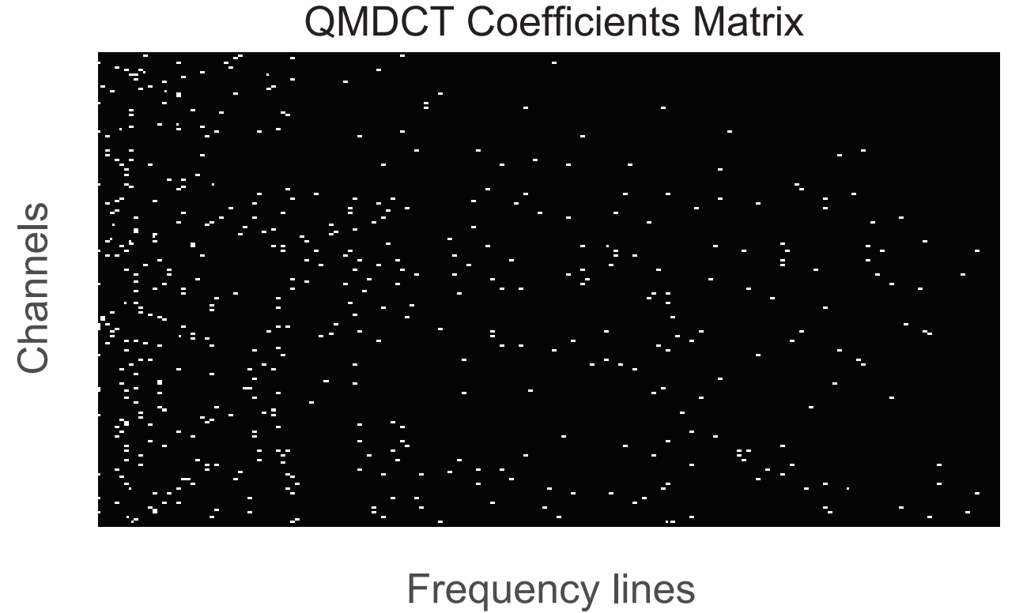
Impact of steganography on MP3 audio
Diagram of
Waveform in the time domain
Diagram of QMDCT coefficients matrix
Blue line: cover signal
Red line: diff signal (cover - stego)
Weight points: diff signal (cover – stego)
Notes:
Now, we can see the impact of steganography on MP3 audio. We analyze the impact in time domain and frequency domain separately. In the left figure, the blue line is the cover signal and the red line represents the signal introduced by stego messages. In the right figure, the white dots are the signal introduced by stego messages. By comparing the two figures and taking the present before into consideration, we choose the QMDCT coefficients matrix as the input data of our network.

Slide 13
Outline
1. Introduction
2. Impact of Steganography on MP3 Audio
3. Structure of Network
4. Experiments and Analysis
5. Conclusion
Notes:
Now, I will elaborate the structure of the network.

Slide 14
Structure of Network
Structure of Wang Deep Audio Steganalysis Network (WDASN)
Input data
Activation function
“Enlarge” stego signal
Activation function
Convolutional block
Size of Output
Subsampling
Notes:
First, the QMDCT coefficients matrix of MP3 is extracted as the input data of the network. A high pass filter follows to get the residual [rɪˈzɪdjuəl] signal in order to capture the minor modification introduced by the steganographic algorithms better. Then, six block convolutional layers are followed in cascade. Each block is a combination of convolutional layers of 3 by 3 and 1 by 1 kernel, a Tanh activation function, and a max pooling layer. And we introduce the batch normalization layers in the last three blocks.
Finally, the fully connected layers are placed at the end of the network and the cross-entropy loss is used to update the parameters.

Slide 15
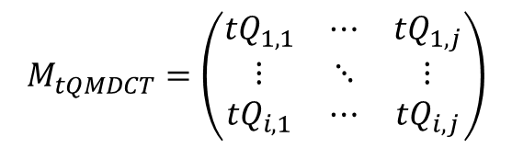
Structure of Network
ASDIIE (Audio Steganalysis Dataset, IIE)
$$M_{tQMDCT}=\left(\begin{matrix}{tQ}_{1,1} & ⋯ & {tQ}_{1,j} \\ ⋮ & ⋱ & ⋮ \\ {tQ}_{i,1} & ⋯ & {tQ}_{i,j}\end{matrix}\right)$$
Dataset | Name | ASD (Audio Steganalysis Dataset)
 | Number | 22671 (increasing…)
 | Format | WAV
 | Channel | Stereo
 | Duration | 10s (384 frames)
 | Bitrate | 1411kbps
 | Sampling Depth | 16bits
 | Sampling Rate | 44100Hz
MP3-Encoder | Version | Lame-3.99.5
 | Bitrate | 128 / 192 / 256 / 320 kbps, others
Notes:
Before we elaborate the structure of the network, I will introduce the dataset we build. As described above, the QMDCT coefficients matrix is a kind of structural data. Some data augment tricks such as translation, rotation and subsampling are not applicable for audio steganalysis. Therefore, to decrease the danger of overfitting, a large-scale dataset is built for audio steganalysis. The detailed information is listed in the table. All our cover and stego samples are made based on Lame, an open-source MP3 encoder.

Slide 16
Structure of Network
Fine-tune of the network
ID | The description of the modification | Accuracy | Iterations
a | The proposed network | 90.39 | 5000
b | Remove the batch normalization layer in the first group | 84.51 | 4000
c | Remove the batch normalization layers in the first two groups | 87.13 | 4500
d | Remove the batch normalization layers in the first four groups | 79.46 | 12000
e | Remove all batch normalization layers | 50.67 | -
f | Remove the high pass filter layer | 88.87 | 10000
g | Remove all 1 × 1 convolutional layers | 86.73 | 7000
h | Average pooling layer is used for subsampling | 56.21 | -
Experimental setting: EECS, 128kbps, W=2, H=7
Notes:
Then, We boost the performance of the network via fine-tuning the structure to make the network more applicabel to MP3 steganalysis. So, in this part, we illustrate the function of each layer based on the experimental results. All experiments are implemented to detect the EECS algorithm with the bitrate of 128 (on two eight) kbps. Here, W and H is the width and height of parity-check matrix [ˈmeɪtrɪks] of STC. We use the variable W as the relative payload of EECS algorithm in our paper.

Slide 17
Structure of Network
Fine-tune of the network
ID | The description of the modification | Accuracy | Iterations
a | The proposed network | 90.39 | 5000
i | Convolutional layer with stride 2 is used for subsampling | 60.75 | -
j | Replace the convolutional kernel with 5 × 5 kernel | 90.36 | 9000
k | Introduce the ABS layer at the top of HPF layer | 87.66 | 7000
l | Introduce the ABS layer at the bottom of HPF layer | 88.35 | 8000
m | Replace all the activation function Tanh with ReLu and introduce the ABS layer at the top of HPF layer | 58.27 | -
n | Replace all the activation function Tanh with ReLu | 51.09 | -
o | Deepen the network to 7 blocks | 88.54 | 7500
Experimental setting: EECS, 128kbps, W=2
Notes:
All results of the variant are shown in this table. Now, we will elaborate one by one. There are 15 different networks. The iterations is used to represent the convergence of the network. And the accuracy is used to show the performance of the network. Batch-size is set as 128

Slide 18
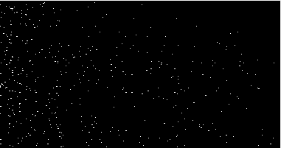
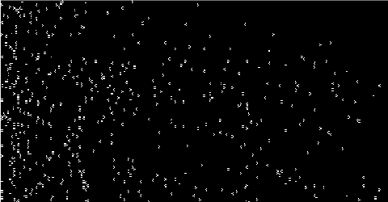
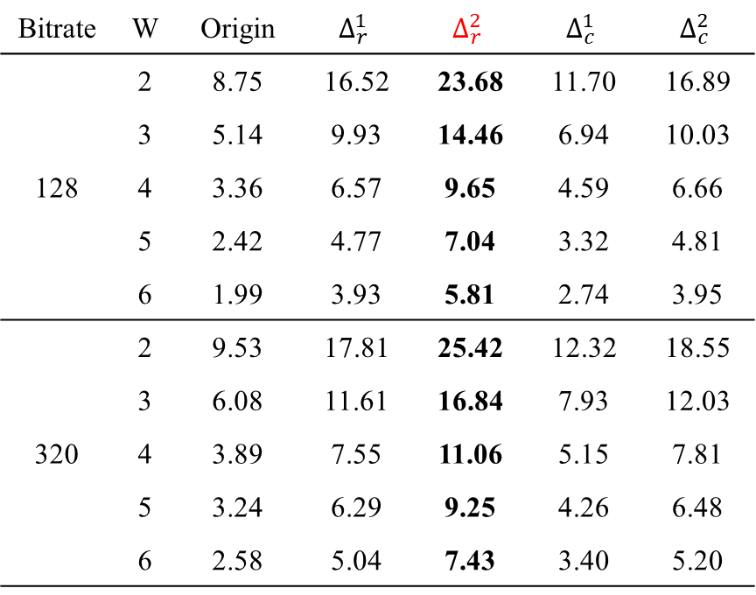

Structure of Network
High Pass Filter (HPF)
Bitrate | W | Origin | $$Δ_{r}^{1}$$ | $$Δ_{r}^{2}$$ | $$Δ_{c}^{1}$$ | $$Δ_{c}^{2}$$
128 | 2 | 8.75 | 16.52 | 23.68 | 11.70 | 16.89
 | 3 | 5.14 | 9.93 | 14.46 | 6.94 | 10.03
 | 4 | 3.36 | 6.57 | 9.65 | 4.59 | 6.66
 | 5 | 2.42 | 4.77 | 7.04 | 3.32 | 4.81
 | 6 | 1.99 | 3.93 | 5.81 | 2.74 | 3.95
320 | 2 | 9.53 | 17.81 | 25.42 | 12.32 | 18.55
 | 3 | 6.08 | 11.61 | 16.84 | 7.93 | 12.03
 | 4 | 3.89 | 7.55 | 11.06 | 5.15 | 7.81
 | 5 | 3.24 | 6.29 | 9.25 | 4.26 | 6.48
 | 6 | 2.58 | 5.04 | 7.43 | 3.40 | 5.20
$$Δ_{r}^{2}$$
Notes:
First, High pass filter. As we know, the steog signal can be seen as high frequency noise compared with content itself. So to reduce the impact of content information and capture the minor modification introduced by stego messages. High pass filter is introduced. In our paper, we choose the second row differences as the high pass filter. This pre-processing method is simple, but it is effective.
All data in this table is the percentage of different points in non-zero coefficients. As we can see, the proportion is almost three times as much as origin via the second order differences. We also can see that the difference is enlarged from right figure.

Slide 19
Structure of Network
High Pass Filter (HPF)
ID | The description of the modification | Accuracy | Iterations
a | The proposed network | 90.39 | 5000
f | Remove the high pass filter layer | 88.87 | 10000
Something about HPF layer
Accelerate the training of the network
Boost the performance of the network
Notes:
From the experimental results, we can find the HPFs makes a great difference. Of course, more effective high pass filter can be designed as kv kernel based on the statistics of audio.

Slide 20
Structure of Network
Convolutional Layer
ID | The description of the modification | Accuracy | Iterations
a | The proposed network | 90.39 | 5000
g | Remove all 1 × 1 convolutional layers | 86.73 | 7000
Something about 1x1 Conv layer
Accelerate the training of the network
Boost the performance of the network
Notes:
In consideration of the truth that every codeword in the big-value region corresponds two QMDCT coefficients and a large proportion of coefficients belongs to the big-value region. The 3 by 3 kernel is selected for feature. Besides, the kernel with size of 1 is used for interaction and information integration across channels. And the 1 by 1 kernel also can be used to reduce the number of parameters to decrease the danger of overfitting.
The result shows us that the introduction of 1 times 1 convolutional layers is conducive to improve the performance of the network.

Slide 21
Structure of Network
Batch Normalization Layer (BN)
ID | The description of the modification | Accuracy | Iterations
a | The proposed network | 90.39 | 5000
b | Remove the batch normalization layer in the first group | 84.51 | 4000
c | Remove the batch normalization layers in the first two groups | 87.13 | 4500
d | Remove the batch normalization layers in the first four groups | 79.46 | 12000
e | Remove all batch normalization layers | 50.67 | -
Something about BN layer
Accelerate the training of the network
Boost the performance of the network
Redundant BN layers will decrease the accuracy
Notes:
Now, we will show the function of BN layer. BN layer is widely used in the design of networks. So we try to use this trick in our netwok. As we can see from the experimental results. The accuracy is greatly different whether there is BN layer or not. And the number of BN layers has a great impact on the final detection. The BN layer is conducive to boost the convergence and final accuracy of the network, but the redundant [rɪˈdʌndənt] BN layers will decrease the final accuracy. Thus, take the speed and precision into account, we remove the BN layers in the first three groups.

Slide 22
Structure of Network
Pooling layer
ID | The description of the modification | Accuracy | Iterations
a | The proposed network | 90.39 | 5000
h | Average pooling layer is used for subsampling | 56.21 | -
i | Convolutional layer with stride 2 is used for subsampling | 60.75 | -
“texture”
Something about pooling layer
Max pooling layer is more applicable to MP3 steganalysis
Notes:
This slide is about the selection of subsampling method. We will present the impact of different subsampling methods on the final accuracy. First of all, as we know, the stego messages are apt to be embedded into the texture region. While the max pooling layer tends to retain the texture information. And the average pooling retains the background information. According to our experimental results, the performance of the network with the max pooling layer is beteer.

Slide 23
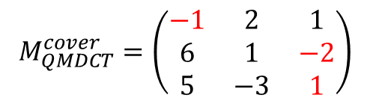
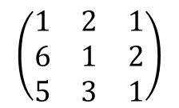
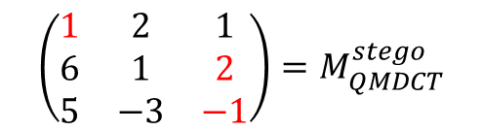
Structure of Network
ABS layer
ID | The description of the modification | Accuracy | Iterations
a | The proposed network | 90.39 | 5000
k | Introduce the ABS layer at the top of HPF layer | 87.66 | 7000
l | Introduce the ABS layer at the bottom of HPF layer | 88.35 | 8000
$$M_{QMDCT}^{cover}=\left(\begin{matrix}−1 & 2 & 1 \\ 6 & 1 & −2 \\ 5 & −3 & 1\end{matrix}\right)$$
ABS
$$\left(\begin{matrix}1 & 2 & 1 \\ 6 & 1 & 2 \\ 5 & 3 & 1\end{matrix}\right)$$
ABS
$$\left(\begin{matrix}1 & 2 & 1 \\ 6 & 1 & 2 \\ 5 & −3 & −1\end{matrix}\right)=M_{QMDCT}^{stego}$$
Something about ABS layer
ABS layer is bad for performance improvement, which may because the introduction of ABS layer reduce the difference between cover and stego
Notes:
Next, the ABS layer. Unlike image, there are many negative values in the QMDCT coefficients matrix. To analyze the impact of negative values on the final detection and the selection of activation function, we introduce the abs layer. As we can see from the experimental results, the introduction of ABS layer does not improve the performance of the network. We deem that the introduction of ABS layer will reduce the difference between cover and stego as the matrix shows.

Slide 24
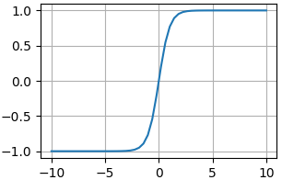
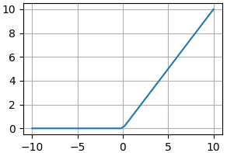
Structure of Network
Activation function
ID | The description of the modification | Accuracy | Iterations
a | The proposed network | 90.39 | 5000
m | Replace all the activation function Tanh with ReLu and introduce the ABS layer at the top of HPF layer | 58.27 | -
n | Replace all the activation function Tanh with ReLu | 51.09 | -
Something about activation function layer
The activation function Tanh with finite range is more applicable to the MP3 steganalysis
Notes:
Activation function ReLu is mostly used in the image classification. But, in MP3 steganalysis, ReLu is not applicable. The network with ReLu is difficult to converge and the detection accuracy drops sharply compared with Tanh. We think that the finite range of Tanh contributes to the convergence of the network.

Slide 25
Structure of Network
The size of convolutional kernel
ID | The description of the modification | Accuracy | Iterations
a | The proposed network | 90.39 | 5000
j | Replace the convolutional kernel with 5 × 5 kernel | 90.36 | 9000
Something about the size of convolutional kernel
3x3 convolutional kernel is effective for MP3 steganalysis
Notes:
Then, in consideration of the truth that every huffman code in count1 region corresponds to four QMDCT coefficients, we introduce the 5 times 5 convolutional kernel. Well, a large kernel with large local receptive fields may be benefit for the improvement of performance of the network. However, the detection accuracies of two different size of kernel are basically the same and more parameters are introducd by the 5 by 5 kernel. Thus, the 3 by 3 kernel is enough.

Slide 26
Structure of Network
The depth of network
ID | The description of the modification | Accuracy | Iterations
a | The proposed network | 90.39 | 5000
o | Deepen the network to 7 blocks | 88.54 | 7500
Something about the depth of network
Better accuracy is not from the network stack or deepening simply
Notes:
Finally, we will talk about the impact of network depth on the final detection. In general, more features of the input data can be captured by a deeper network. However, overfitting and vanishing gradient make a deeper network more difficult to be trained. According to the results shown in the table, the detection accuracy drops due to the deepening of the network. Therefore, it is not advisable to stack or deepen the network simply.

Slide 27
Outline
1. Introduction
2. Impact of Steganography on MP3 Audio
3. Structure of Network
4. Experiments and Analysis
5. Conclusion
Notes:
Now, we will present the experiment settings and results.

Slide 28
Experiments and Analysis
Experimental settings
Item | Value | Parameters
Dataset | Train Set | 16000
 | Validation Set | 4000
 | Test Set | 2671
 | Bitrate | 128 / 320
 | Frames | 50
 | Channel | Stereo
Steganographic Algorithms | HCM-Gao | RER=0.1, 0.3, 0.5
 | HCM-Yan
 | EECS | W = 2, 3, 4, 5; H = 7
Hyper Parameters | Initial Learning Rate | 1e-3
 | Initial Method of Weights | Xavier
 | Batch Size | 64 / 16
Notes:
This table shows the experimental settings in our paper. In every epoch, there 16000 (sixteen thousand) cover/stego pairs are set for training, and the other 4000 pairs are for validation. The rest are for test to compare the performance of our network and the traditional handcrafted features. In our paper, three MP3 steganographic algorithms in the entropy code domain are detected. RER is the abbreviation of relative embedding rate. W and H are the width and height of the parity-check matrix. The initial learning rate of our network is 1e-3 (one per thousand), and we use exponential [ˌekspəˈnenʃl] decay function with a decay rate of 0.9 and decay steps of 5000.

Slide 29
Experiments and Analysis
Compared MP3 Steganalytic Algorithm
Markov Feature (Jin)
Extract Markov transition probabilities of Intra and Inter frame(C. Jin et al., MTAP, 75(6), 2017)
MDI2 (Ren)
Extract Markov Transition Probabilities and Accumulative
Neighboring Joint Density of Intra and Inter frame(Y. Ren et al., IWDW, 217-231, 2017)
Notes:
To assess our scheme comprehensively, two state-of-the-art handcrafted features are compared with the proposed network.

Slide 30

Experiments and Analysis
Experimental Results (HCM-Gao)
Bitrate | RER | WDASN | Ren | Jin
128 | 0.1 | 70.72 | 50.13 | 50.11
 | 0.3 | 75.18 | 51.41 | 52.34
 | 0.5 | 78.53 | 53.75 | 52.79
320 | 0.1 | 73.83 | 50.77 | 50.85
 | 0.3 | 77.27 | 55.18 | 53.63
 | 0.5 | 80.71 | 62.69 | 59.42
$$RER=\frac{number of embedding frames}{ number of all frames}$$
Notes:
Following is the experimental results. This is the result of HCM-Gao.

Slide 31
Experiments and Analysis
Experimental Results (HCM-Yan)
Bitrate | RER | WDASN | Ren | Jin
128 | 0.1 | 75.92 | 50.94 | 51.25
 | 0.3 | 81.39 | 56.88 | 60.31
 | 0.5 | 85.88 | 76.56 | 72.50
320 | 0.1 | 79.35 | 64.38 | 54.69
 | 0.3 | 83.09 | 66.56 | 62.50
 | 0.5 | 90.21 | 77.81 | 77.19
$$RER=\frac{number of embedding frames}{ number of all frames}$$
Notes:
This is the result of HCM-Yan.

Slide 32
Experiments and Analysis
Experimental Results (EECS)
Bitrate | W | WDASN | Ren | Jin
128 | 2 | 90.39 | 59.42 | 56.25
 | 3 | 80.17 | 53.37 | 53.81
 | 4 | 67.82 | 51.96 | 51.73
 | 5 | 54.78 | 50.56 | 50.35
320 | 2 | 95.35 | 71.38 | 69.69
 | 3 | 83.09 | 55.81 | 54.56
 | 4 | 72.33 | 52.24 | 52.13
 | 5 | 56.46 | 50.10 | 50.07
Notes:
And this is the result of EECS. For the three steganography algorithms, the detection accuracy of the proposed network is higher than the handcrafted features.

Slide 33
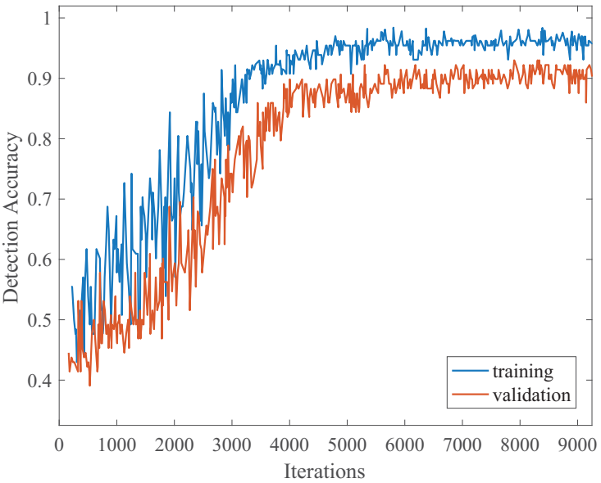
Experiments and Analysis
Accuracy curve (EECS, Bitrate=128kbps, W=2, H=7)
Notes:
This is the detection curve of our proposed network. The detection accuracy in the validation set and train set are basically the same. In other words, our proposed network is applicable [əˈplɪkəbl] to MP3 steganalysis.

Slide 34
Experiments and Analysis
Audio steganalysis of varying size
Notes:
Last but not the least, we take audio steganalysis of varying size into consideration.
For a trained CNN, the input dimension of the fully connected layer is invariant, which means the size of input data is fixed. If the size of test audios are not the same with trained audios, the network can’t be used directly.
In our experiments, suppose the stego messages are embedded into the audio files evenly. The QMDCT coefficients matrix of 200 × 380 (almost duration of 1.3s) is selected as the minimum data unit. To steganalyze audio with varying size, a sliding window with 50% overlap is proposed. The matrix is cropped into several uniform fragments, and each part is 200 × 380. If the remaining segment does not satisfy the scale of 200×380, this segment is dropped directly. Then, the cropped segments are put into the network successively, thus the probability of classification can be obtained. Finally, calculate the average value of all results. If the value is more than 0.5, the audio is judged as stego. Otherwise, it is cover. In our experiments, the final detection accuracy is basically equivalent to the small fragments detection.

Slide 35
Outline
1. Introduction
2. Impact of Steganography on MP3 Audio
3. Structure of Network
4. Experiments and Analysis
5. Conclusion
Notes:
Last, the conclusion.

Slide 36
Conclusion
A effective network is proposed for MP3 steganalysis
The proposed network can be applied to various MP3 steganographic algorithms, bitrates, and relative payloads
Fine-tune the network to improve the performance
A sliding window strategy is presented to steganalyze audios of arbitrary size
GitHub: https://github.com/Charleswyt/tf_audio_steganalysis
Notes:
In our paper, an effective network is proposed for MP3 steganalysis, especially the network can detect the EECS algorithm, an adaptive MP3 steganography which is hard to be detected through traditional handcrafted feature.
And the network can be applied to various steganographic algorithms, bitrates and relative payloads.
Fine-tune the structure of the network to boost the accuracy and decrease the danger of overfitting.
Finally, a sliding window strategy is presented to steganalyze audios of arbitrary size.
All our source code and dataset are now available via GitHub. Hope we can have a friendly communication with each other.

Slide 37
Thank you！
GitHub: https://github.com/Charleswyt/tf_audio_steganalysis
Notes:
Thanks for your listen.

